Slide 1
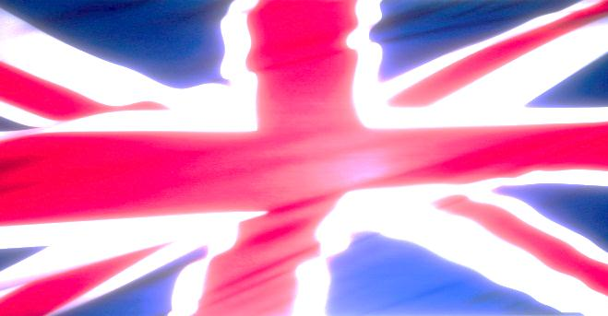
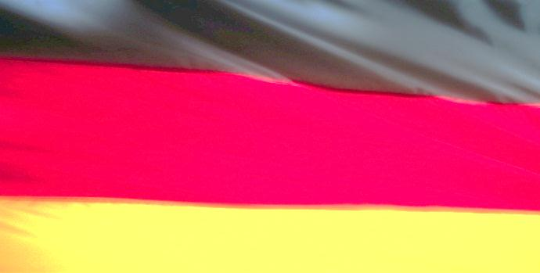
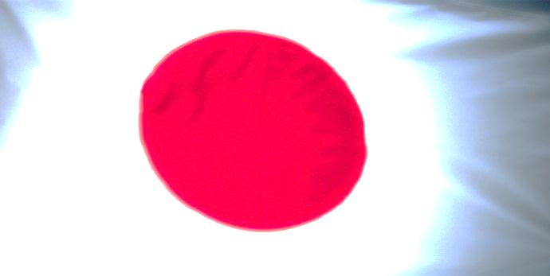
The Global Impact of the Great Depression
High unemployment,
unwilling to get involved
in international disputes
Wall Street Crash
Unemployment and poverty,
increased by austerity policy,
lead to Hitler‘s rise to power
Great Depression
Worried by the Nazis,
begins building a series
of frontier defenses
Economic problems
throughout the
world
Building of an overseas
empire in Africa distracts
people‘s attention from
economic difficulties
Changes in the relations
between countries and
within countries
Unwilling to support
economic sanctions as
long as international
trade is in such a mess
Military expansion in China
as a means to prevent the
economy from complete collapse

